Slide 1
CHAPTER 1
Training
MODULE 3

Slide 2
Meaning of training
According to Edwin Flippo , “Training is the act of increasing the skill of an employee for doing a particular job”.
Dale S. Beach define training as “ the organised procedure by which people learn knowledge and /or skill for a definite purpose”.
Training bridges the difference between job requirements and employee’s present specification .

Slide 3
Area | Training | Development
Content | Technical skill and knowledge | Managerial and behavioral skills and knowledge
Purpose | Specific job related | Conceptual and general knowledge
Duration | Short term | Long term
For whom | Mostly technical and non- managerial personnel | Mostly for managerial personnel

Slide 4
Benefits of training
Benefits to organisation
Leads to improved profitability and / or more positive attitude toward profit orientation
Improves the job knowledge and skills at all levels of the organisation
Improves the morale of the workforce
Helps keep cost down in many areas e.g. production, personnel, administration
Improves labour management relations and increase productivity and quality of work
Creates an appropriate climate for growth , communication
Helps employees adjust to change
Develop a sense of responsibility to the organisation for being competent and knowledgeable
Aids in handling conflict , thereby helping to prevent stress and tension
Aids in developing leadership skill , motivation ,loyalty , better attitude and other aspects that successful workers and managers usually display

Slide 5
Benefits to individual
Helps the individual in making better decision and effective problem solving
Through training and development , motivational variables of recognition, achievement ,growth , responsibility and advancement are internalised and operationalised
Aids in encouraging and achieving
self – development and self- confidence
Helps a person handle stress, tension , frustration and conflict
Provide information for improving leadership knowledge communication skills and attitude
Increases job satisfaction and recognition
Helps eliminate fear in attempting new tasks

Slide 6
Benefits in human relations , intra and intergroup relations
Improves communication between groups and individual
Improves interpersonal skills
Improves morale
Builds cohesiveness in groups
provide a climate for learning , growth and
co-ordination
Makes the organisation a better place to work and live
Provides information on equal opportunity and affirmative action

Slide 7
Need for training
To match the employee specification with the job requirement and organisational needs
Organisational viability and the transformation process
Technological advances
Organisational complexity
Human relations
Change in the job assignment

Slide 8
Training objectives
To prepare the employees both new and old t meet the present as well as the changing requirements of the job and the organization
To prevent obsolescence
To promote individual and collective morale ,a sense of responsibility ,co-operative attitude and good relationship
To prepare employees for higher level task and to develop potentialities of people for the next level job
To impart the new entrants the basic knowledge and skill they need for an intelligent performance of definite job

Slide 9
Steps in training
Need assessment
Program design
Implementation
Evaluation

Slide 10
Assessment of training needs
Organizational analysis
Departmental analysis
Job /role analysis
Employee analysis

Slide 11
Assessment methods
Organizational requirement
Department requirement
Job specifications and employee specification
Identifying specific problems
Anticipating future problems
Management’ s request
Observation
Interview
Group conference
Questionnaire surveys
Test or examination
checklist
Performance appraisal

Slide 12
Training content for different categories of employees
Supervisor training
Sales training
Clerical training
Learning and training

Slide 13
Designing the training program
Instructional objectives
Learning principles
All human being can learn
An individual must be motivated to learn
Learning is active but not passive
Learners may acquire knowledge more rapidly with guidance .Feedback ensures improvement in speed and accuracy of learning.
Learning methods should be varied . Variety of methods should be introduced to off- set fatigue and boredom

Slide 14
Learning principles
Time must be provided to practice learning
Different level of learning exist
The learner must secure satisfaction from learning . Education must fulfils human needs,
desires and expectations
Standards of performance should be set for the learner
Learning should be a goal oriented
Accuracy deserves generally more emphasis than speed
Learning is closely related to attention and concentration
Learning involves long run retention and concentration

Slide 15
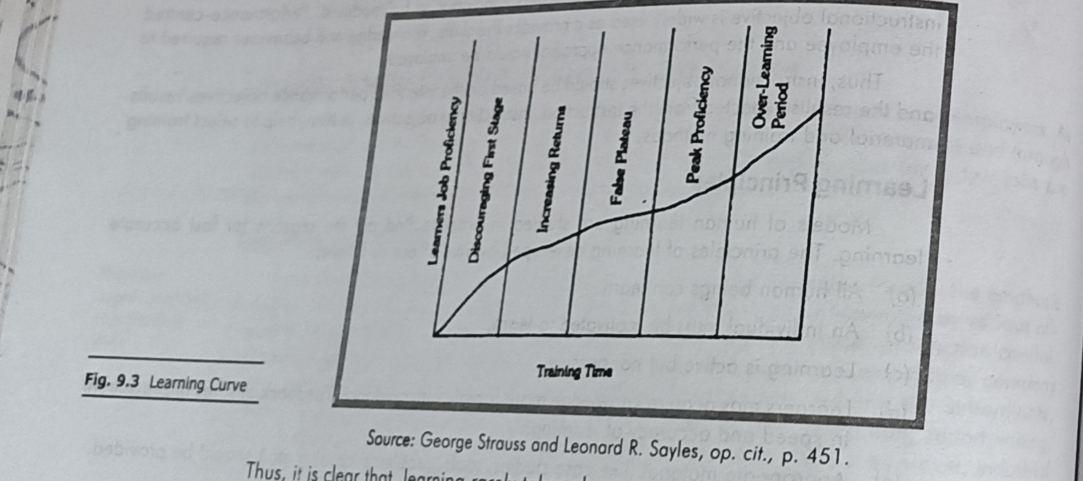
Learning patterns

Slide 16
Characteristics of learning process
Leaning is a continuous process
People learn through their actual personal experience , simulated experience and from others experience
People learn step by step from known to unknown and simple to complex
There is need for repetition in teaching to improve skill and learn perfectly
Practice makes a man perfect . Hence opportunity should be created to use , transfer the skill , knowledge and abilities acquired through learning .
Learning gives satisfaction to the learner
Conflict in learning . It arises when trainer knows or has developed some habits which are incorrect in terms of the method being learned

Slide 17
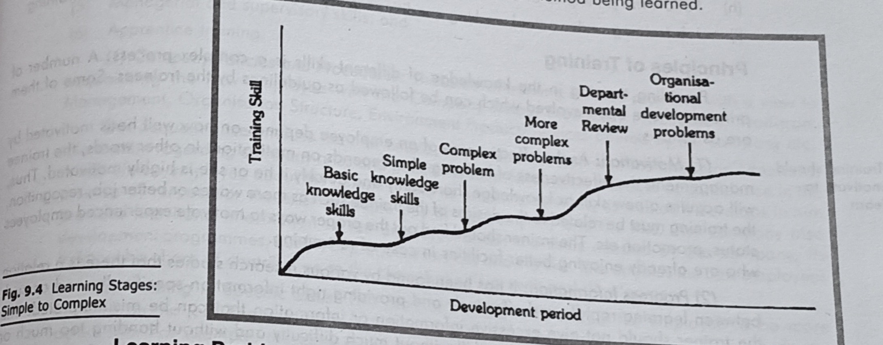

Slide 18
Learning problems
Lack of knowledge , skill , aptitude and favorable attitude
Knowledge and skill not being applied
Existence of anti – learning factors :most operational situation contain a number of elements which will restrict the development of learning regardless the methods employed
Psychological problems like fear and shyness
Inability to transfer of learning to operational situation
Heavy dependence on repetition, demonstration and practice
Unwillingness to change
Lack of interest about the knowledge of results
Absence of self – motivation
Negative attitude about involvement and participation

Slide 19
Teaching principles
The employees must be taught to practice only the correct method of work
Job analysis and motion study techniques should be used .
Job training under actual working conditions should be preferred to classroom training
Emphasis should be given more on accuracy then speed
Teaching should be different time intervals
Follow the principle of best movement of work
Job training under actual working conditions is superior to classroom and formal training
It should be recognized that it is easier to train young workers than old workers due to their decreasing adaptability with the increase in age

Slide 20
Principles of training
Motivation
Progress information
Reinforcement
Practice
Full v/s part
Individual differences

Slide 21
Areas of training
Company policies and procedures
Specific skills
Human relations
Problem solving
managerial and supervisory skill
Apprentice training

Slide 22
Implementation
Training methods
On the job methods | Off the job methods
Job rotation | Vestibule training
Coaching | Role playing
Job instruction | Lecture method
Training through step by step | Conference or discussion
Committee assignment | Programmed instruction
Internship training | Audio – visual method
 | Computer based training and e- learning

Slide 23
Training conduct
Preparing the instructor
Preparing the trainee
Getting ready to teach
Presenting the operation
Try out the trainee’s performance
Follow –up

Slide 24
Evaluation of training program
Training program should be evaluated to correct the shortcomings and improve further.
It can be done in following ways :
Reactions
Learning
Job behavior
Organization
Ultimate value

Slide 25
Advantages of training
Increased productivity
Hightened morale
Reduced supervision
Reduced accidents
Increased organizational stability

Slide 26
Essential ingredients for successful evaluation
Basis for evaluation
Production factor general observation
Human resource factor
Performance test
Cost – value relationship
Feedback

Slide 27
Special aspects of training
Orientation training
Basic skills training – reading , writing computing, speaking , listening ,problem solving , managing one self ,knowing how to learn ,leadership skill
Team training
Process skill - meeting , problem solving , brainstorming , decision making , negotiating ,
goal setting ,presentation ,process analysis , task evaluation ,customer analysis ,project planning , creativity , information management

Slide 28
Behavior skill
Member communication
Conflict resolution
Building trust
Establishing norms
Handing difficult member
Diversity awareness
Team development stages – forming ,storming norming and performing
Team issues / concerns
Team benefits
Features of good team

Slide 29
Diversity training
Employees are of diverse background bring varied of knowledge that helps the organization in making accurate decisions .
Characteristics of effective diversity program
Link the diversity training to organizational strategies
Engage qualified and experienced trainer
Use appropriate method of training
Managers must be accountable for achieving the goals of the training
Document individual and organization benefits

Slide 30
Thank you

